Slide 1
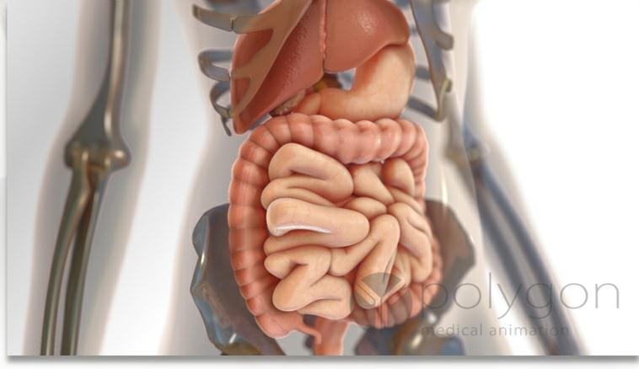
3.2.2 Digestive System Design
Ebenezer Edema-Sillo
Jalen Heyward
D’Essence Rainey
Jade Simmons

Slide 2
Oral Cavity
· What is the oral cavity and what does it contain? The oral cavity is the mouth and it contains the teeth, tongue, lips and cheeks.
· What is the function of the salivary glands? The salivary glands make saliva which helps the food digest so It can go easier down the esophagus.
· What is the function of the tongue? The tongue helps food roll into a bolus which makes it easier to chew and digest. It also allows you to taste your food.
· What is a bolus? A soft mass of chewed food.
· Where the soft and hard palate located and what are are their functions? The hard palate is located at the front of the roof of the mouth. The soft palate is located at the back. The soft palate closes the nasal passages during the act of swallowing. The hard palate divides the nasal passages.
· What mechanical and chemical digestion occurs in the oral cavity? Swallowing is the mechanical digestion that occurs in the oral cavity. The chemical digestion starts when saliva brings enzymes and amylase breaks down all the carbohydrates .
· What mechanisms are in place to make sure food does not “go down the wrong tube” and into the windpipe? The epiglottis covers the larynx to prevent food from entering the airway.
·

Slide 3
Esophagus and Stomach
What is the peristaltic movement and how does it function in the esophagus?
Peristaltic movement occurs when muscles contract behind chewed in order to move food through the esophagus.
Does any digestion of food occur in the esophagus?
No
What are the primary functions of the stomach?
The stomach breaks down food and extracts nutrients necessary for the body.
What is chyme and how does the stomach mix this material?
Chyme is creamy material produced by digestion of food. Food enzymes, and gastric juices all mix in the bottom of the stomach to make Chyme.
What role does the stomach play in decontaminating the incoming food matter?
The stomach kills bacteria located within digested food.
What cells in the stomach function to form enzymes and acids?
Parietal cells, they create acid.
Chief cells, they create pepsinogen.
Why doesn’t gastric juice digest the inside of the stomach?
Because the stomach is protected by alkaline.
What are sphincters and how are they related to the stomach?
Sphincters are muscles that relax or contract to allow material to pass through. The stomach has 2. One to keep the stomach acid in and the other to allow the flow of food.
What mechanical and chemical digestion occurs in the stomach?
Mechanical digestion is when the stomach churns the food and mixes the food with the acid in the stomach.
Chemical digestion is when the chemicals and acids in the stomach break down the food in the stomach.

Slide 4
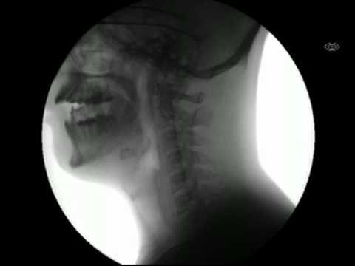

Slide 5
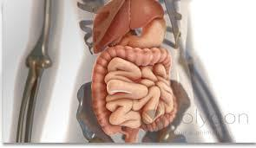
Small Intestine
Duodenum: processing and digesting chyme
mixes bile and pancreatic enzymes
Jejunum: digests and absorbs macromolecules from partially digested food
Ilium: absorbs B-12 and bile salts
pH Level: 7
use of buffers(ex. minerals) in order to maintain pH level

Slide 6
Small Intestine
pancreas releases pancreatic enzymes to the duodenum
liver and gallbladder release bile to the duodenum
food moves through the intestines via peristalsis

Slide 7
Small Intestine
amylase: breaks down polysaccharides( ex. carbs) into monosaccharides
lactase: breaks down lactose into glucose and galactose
lipase: digestion of dietary fat
protease: breaks down peptide bonds of proteins

Slide 8
Large Intestine
reabsorbs water from indigestible food
expels waste from the body
ascending colon: carries ingested matter from the cecum to the transverse colon

Slide 9
Large Intestine
transverse colon: forms feces and expels water
descending colon: absorbs water from fecal matter
stores food particles that will be sent to the rectum
sigmoid colon: stores fecal matter until they are expelled from the body
controls water balance of the body by absorbing water from fecal matter
too much absorbed(leads to constipation)
not enough absorbed(leads to diarrhea)

Slide 10
Pancreas
6 inches long
located at the back of the abdomen
head of the pancreas is located on the right side of the abdomen
secretes digestive enzymes into the small intestine
makes insulin to control blood sugar

Slide 11
Pancreas
connects to the duodenum(first section of the small intestine)
secretes enzymes that break down polymers
trypsin: breaks down proteins into small peptides
chymotrypsin: accelerates the rate in which peptide bonds are broken down
insulin is released in response to an increase in blood sugar

Slide 12
Liver
largest organ in the body
sits on the right side of the stomach
produces bile for digestive processes
detoxifies the blood
stores vitamins and iron
destroys old blood cells

Slide 13
Gallbladder
Bile is transported from the liver to the gallbladder
Bile is then transported to the small intestine
bile contains bile acids(critical for digestion and absorption of fat in the small intestine)
bile enters the digestive tract through the stomach

Slide 14
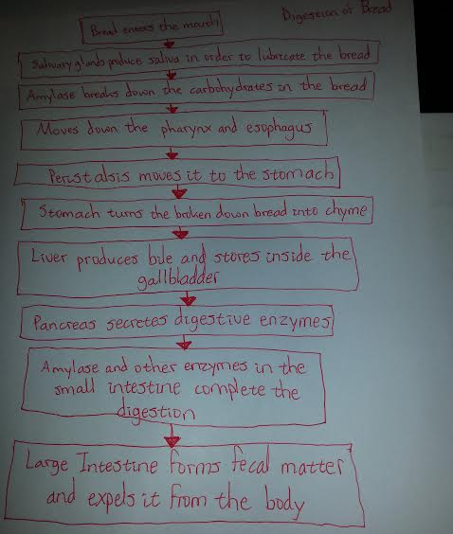
Digestion of Bread

Slide 15
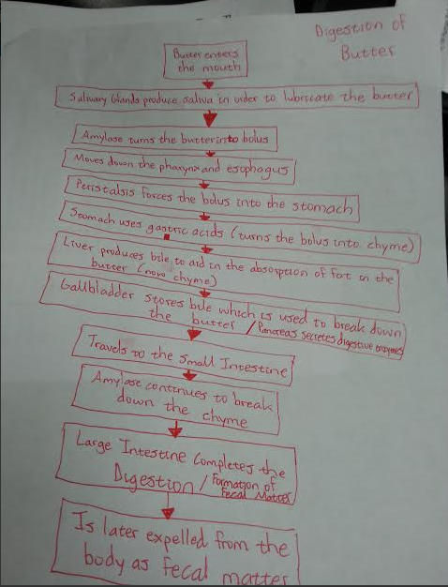
Digestion of Butter

Slide 16
Works Cited
Khan, Sumaiya. (2010, Feb 20). Small Intestine Anatomy. Retrieved from: http://www.ibuzzle.com/articles/small-intestine-anatomy.html
Hendrickson, Kirsten. (2014, Feb 3). What Are the Functions of Lipase Enzymes? Retrieved from: http://www.livestrong.com/article/410168-what-are-the-functions-of-lipase-enzymes/
Bowen, R. (2006 July 5). Exocrine Secretions of the Pancreas. Retrieved from: http://www.livestrong.com/article/410168-what-are-the-functions-of-lipase-enzymes/
Krucik, George. (2013, Apr 24). Liver. Retrieved from: http://www.healthline.com/human-body-maps/liver

